Slide 1
Homework 5 Case Study
ANALYSIS OF SCVB CASE
BUS2 194A Sec 80
Date: May 5, 2022
Group 3
Contributors: Yung-Ching Chang, Bisesh Ghimire, Chieh-Shu Juan, Amanda Medeiros, Anna Nguyen

Slide 2
Agenda:
Analyze the scatter plot
The logistic regression model
Predict the probability of customers that will enroll in direct payroll deposit
The estimated odds ratio

Slide 3
Introduction:
SCVB managers want to get more customers to use direct payroll deposit
Account balance can be used as the predictor for deposit variable
The managers only want to contact customers that have probability of 50% or more of signing up for direct payroll deposit

Slide 4
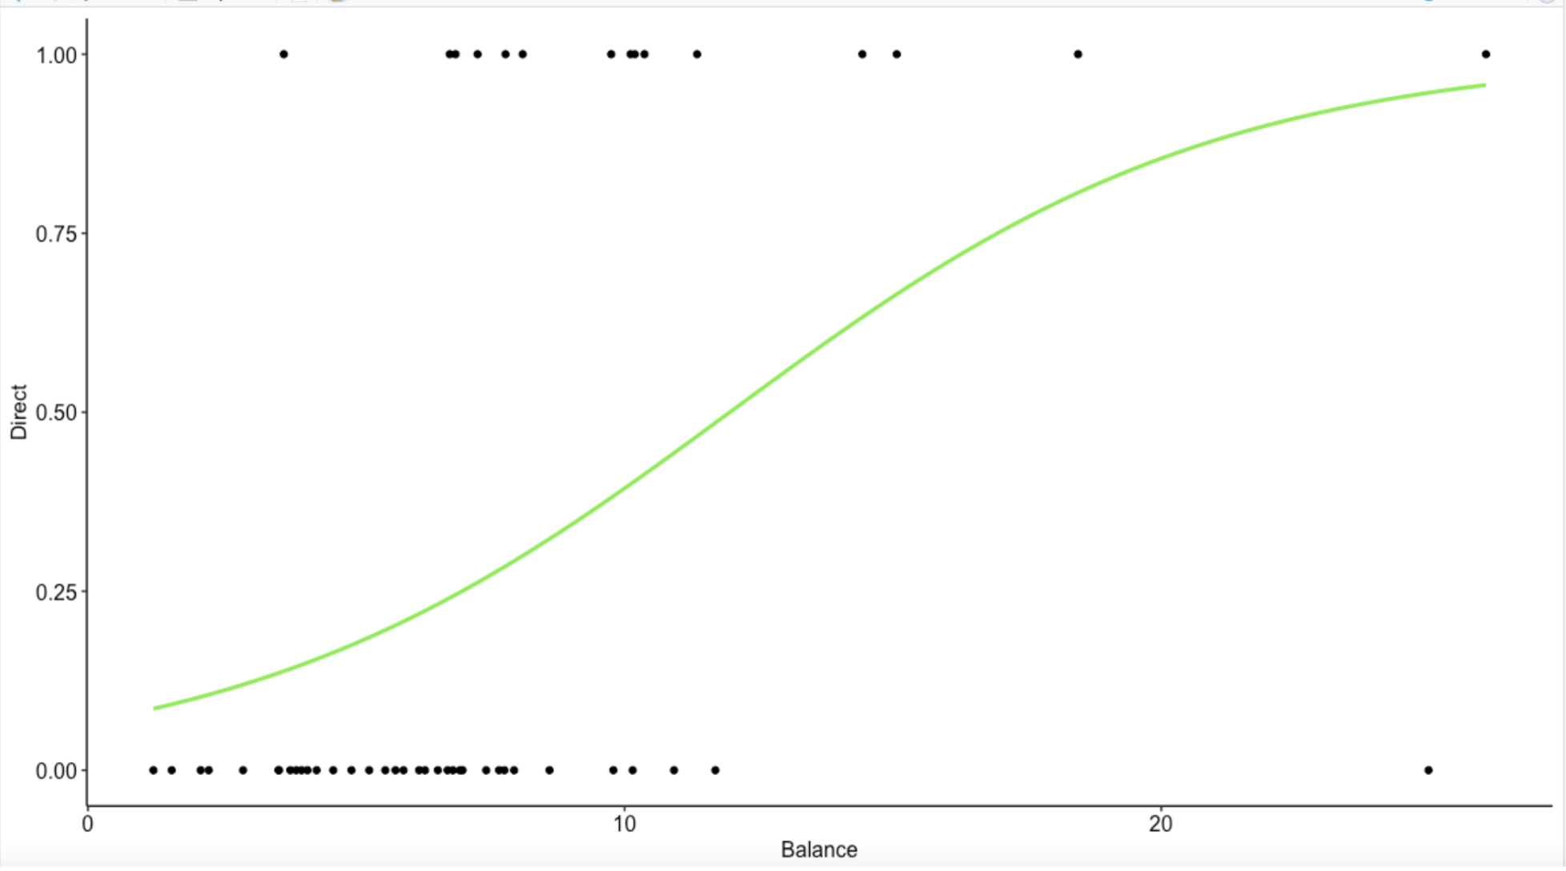
Results: Scatter Plot

Slide 5
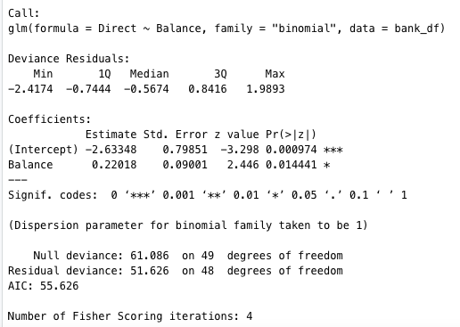
Results: Logistic Model
Y hat =( e^Bo + B1*X)/(1 + e^Bo + B1*X), X is Balance variable
Y hat=(e^(-2.633+.22x))/
(1+e^(-2.633+.22x))
Notes:
Y equal to If the consumer did not sign up for direct deposit, the value is 0. And 1 is whether the consumer has opted for direct deposit. X is the average monthly balance in a customer’s account. So the Y hat=(e^(-2.633+.22x))/
(1+e^(-2.633+.22x)). And this value is come out about the first equations.

Slide 6
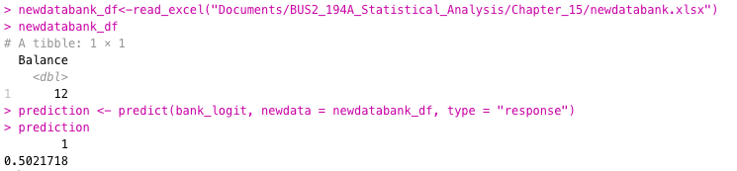
Results: Prediction
→ The probability that customers with an average monthly balance of $1200 will sign up for direct payroll deposit is 50.2%.

Slide 7
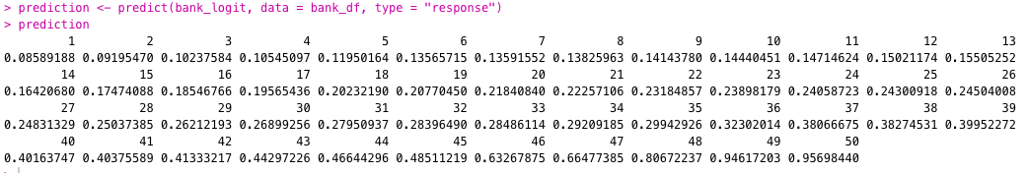
Results: Prediction (cont.)
→ The average monthly balance should be $1200 or more to achieve 0.5 or higher probability of signing up for direct payroll deposit.
Notes:
46 is the customer number, it can be interpreted as the customer number 46 and up have 50% or higher probability of signing up for deposit since their account balance is more than $1200, in the Excel file their balance is on the second column

Slide 8
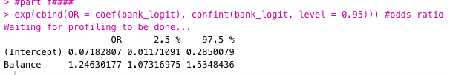
Results: Estimated Odds Ratio
-> Since the value 1 isn’t in the confidence interval we can conclude that the odds ratio relationship is significant for balance (x1)
The odds in favor of signing up for deposit Is 1.246 times as likely for customers with any increase of one-unit (increase of $100) in their account balance than customers without increase of $100 in their balance

Slide 9
Conclusion and Recommendations
The more money the customers have in their account, the higher the probability that they will sign up for direct payroll deposit
If the management team wants to have 50% or higher probability of customers signing up for deposit, we suggest them to contact customers that have more than $1200 in their account balance
The management team may consider starting a marketing campaign to convince customers to put more money in their account
Notes:
It is worth mentioning that for any increase of more than $100 in account balance, the likelihood of customers signing up for deposit will also increase

